Slide 1
Unit 1: Should animals be kept in zoos or not?
Are zoos a good idea?
20211397 KangDongmin

Slide 2
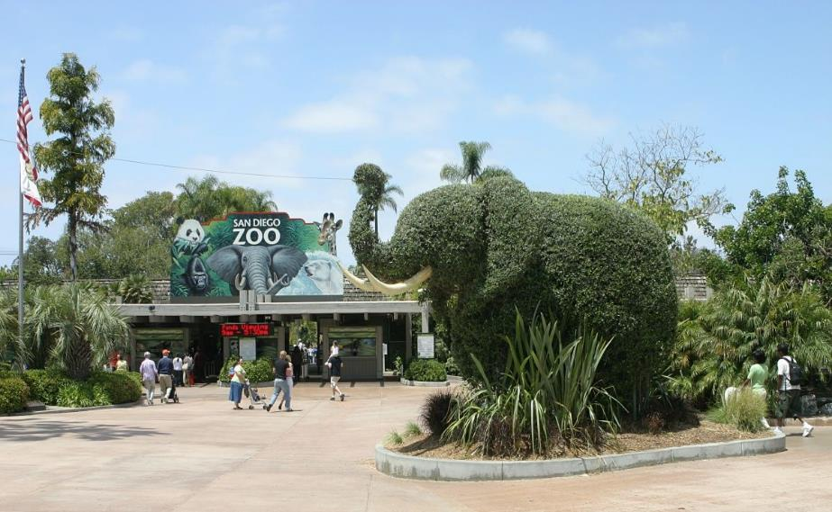
Basic rights

Slide 3
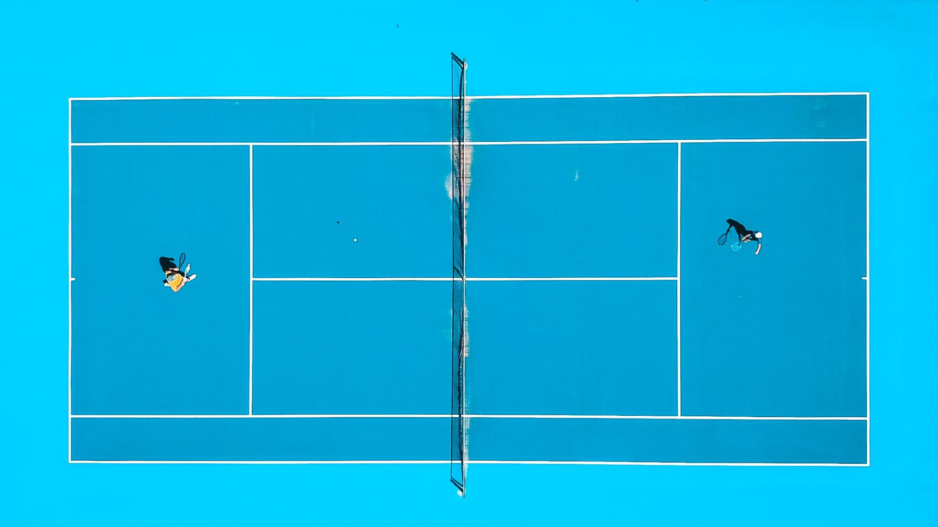
we need a zoo

Slide 4
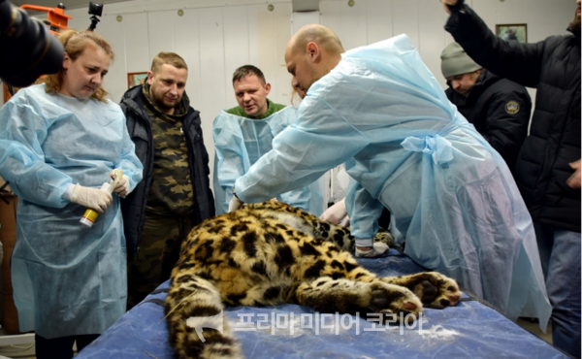
「
zoos are not places to capture wild animals.
」

Slide 5


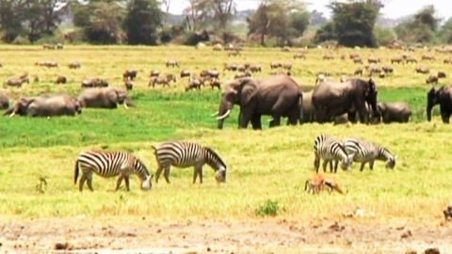

Treated
Still sick

Slide 6
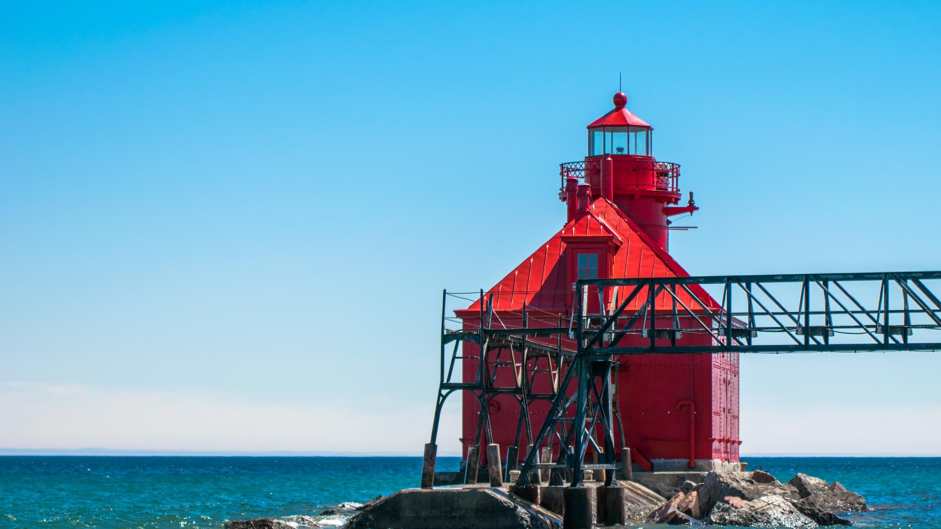
Zoos play a role in preserving and researching biodiversity.

Slide 7



zoo
research institutes

Slide 8
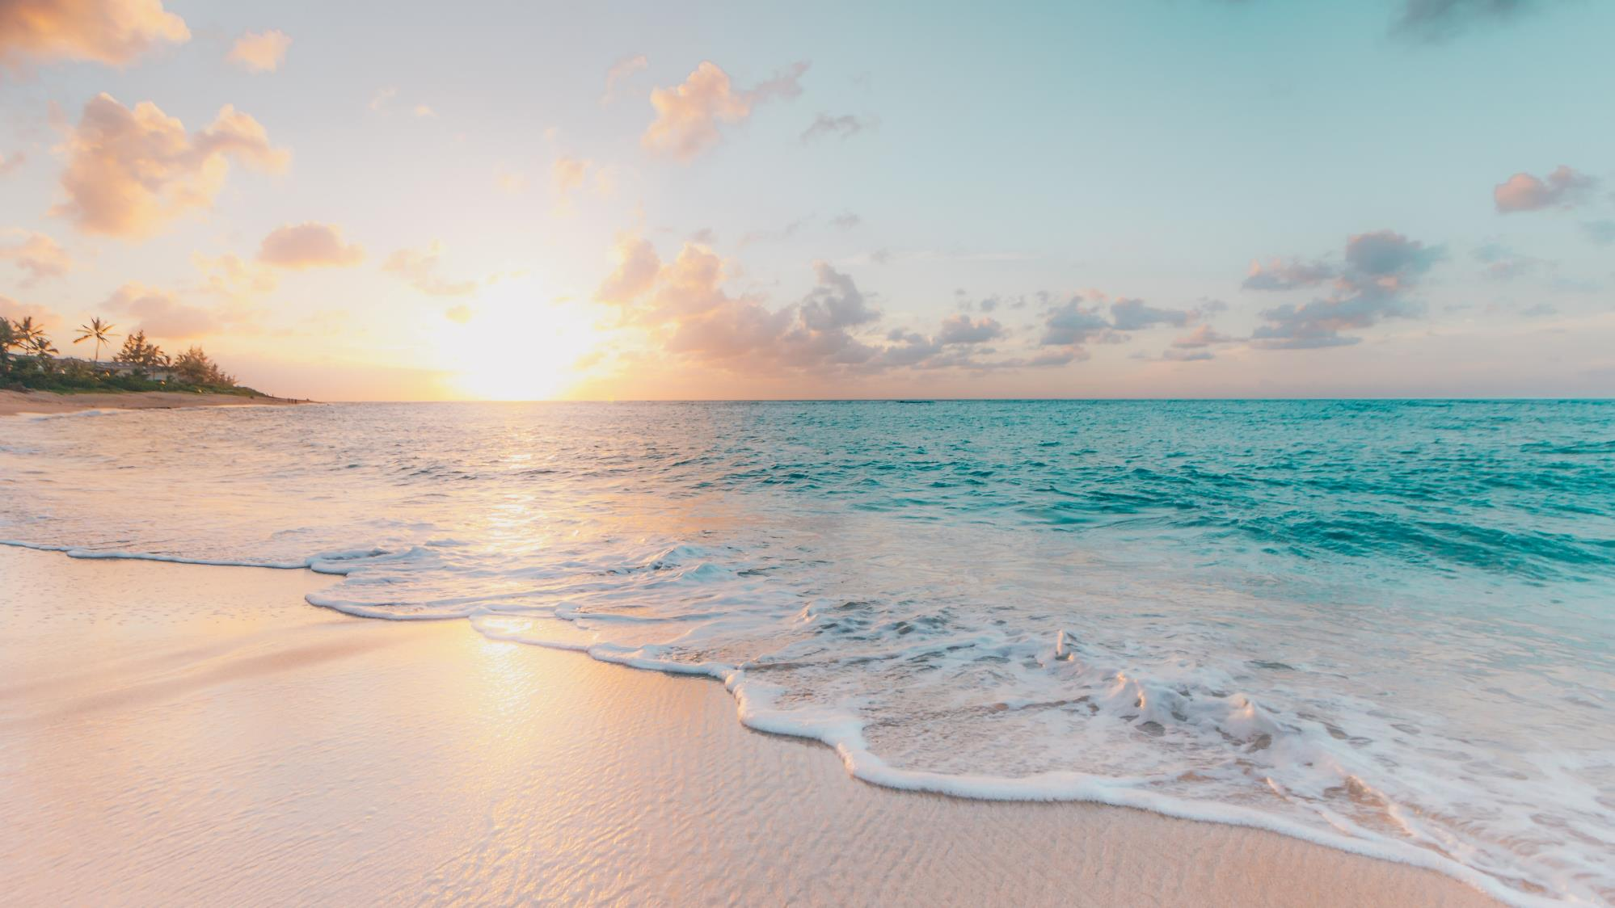
There is no suitable place to release animals.

Slide 9
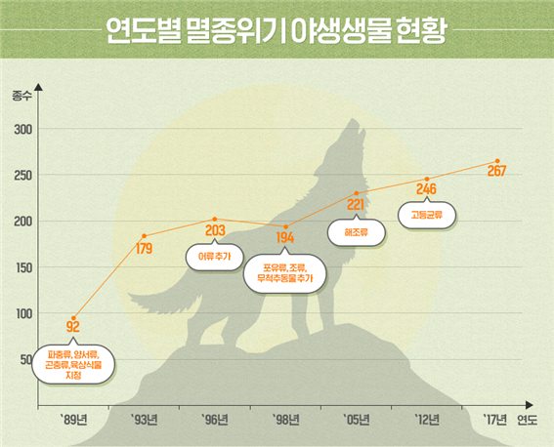
Status of endangered wildlife by year

Slide 10
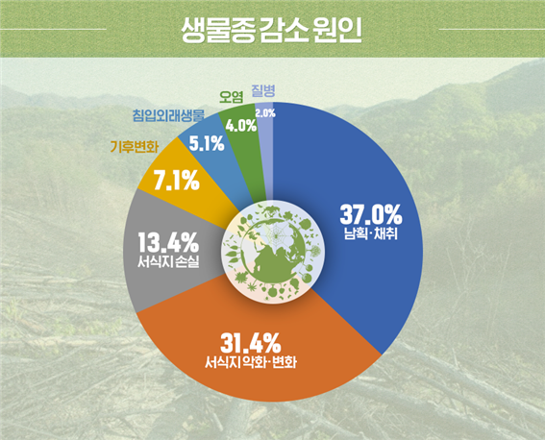
The cause of the decrease in species.
overhunting
excessive development

Slide 11
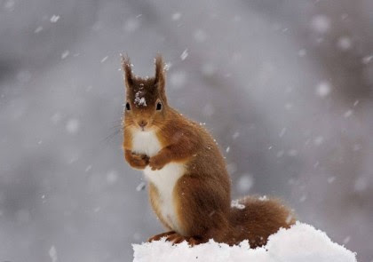

Slide 12
Thank you for listening to my presentation!

